Slide 1
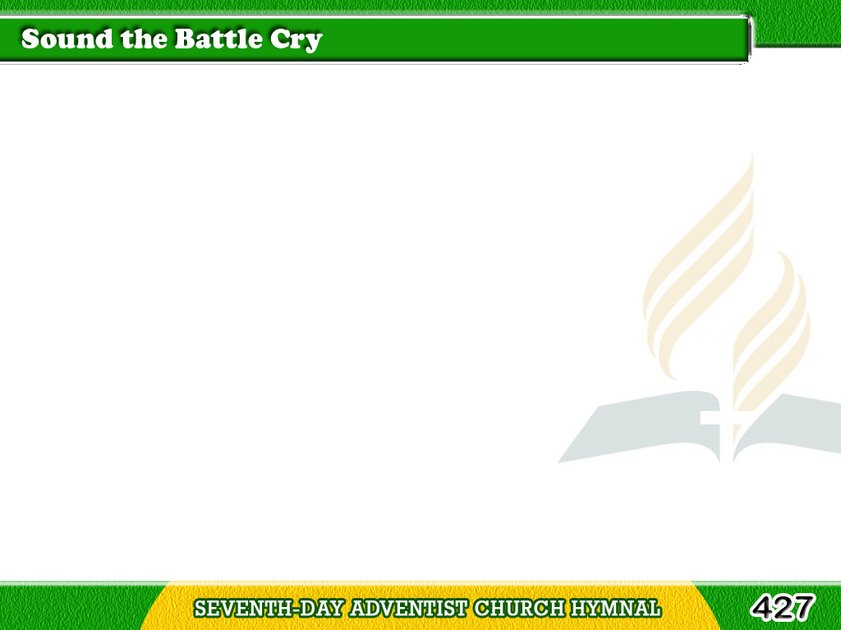
1/3
Sound the battle cry,
See! the foe is nigh;
Raise the standard high
For the Lord;
Tagalog
Version

Slide 2
1/3
Gird your armor on,
Stand firm, every one,
Rest your cause upon
His holy word.
Tagalog
Version

Slide 3
1/3
Rouse, then, soldiers!
rally round the banner!
Ready, steady,
pass the word along;
Tagalog
Version

Slide 4
1/3
Onward, forward,
shout aloud hosanna!
Christ is Captain
of the mighty throng.
Tagalog
Version

Slide 5
2/3
Strong to meet the foe,
Marching on we go,
While our cause we know
Must prevail;
Tagalog
Version

Slide 6
2/3
Shield and banner bright,
Gleaming in the light,
Battling for the right,
We ne’er can fail.
Tagalog
Version

Slide 7
2/3
Rouse, then, soldiers!
rally round the banner!
Ready, steady,
pass the word along;
Tagalog
Version

Slide 8
2/3
Onward, forward,
shout aloud hosanna!
Christ is Captain
of the mighty throng.
Tagalog
Version

Slide 9
3/3
O Thou God of all,
Hear us when we call,
Help us, one and all,
By Thy grace;
Tagalog
Version

Slide 10
3/3
When the battle’s done,
And the victory won,
May we wear the crown
Before Thy face.
Tagalog
Version

Slide 11
3/3
Rouse, then, soldiers!
rally round the banner!
Ready, steady,
pass the word along;
Tagalog
Version

Slide 12
3/3
Onward, forward,
shout aloud hosanna!
Christ is Captain
of the mighty throng.
Tagalog
Version

